Slide 1

Next Steps
BOOTCAMP PREP

Slide 2

Fullstack Academy
Full-Time Web Development Immersive
17 weeks (4 weeks part-time & remote, 13 weeks on campus)
Part-Time Web Development Immersive
26 weeks (4 weeks part-time & remote, 22 weeks on campus)
Grace Hopper Program/Track
For those who identify as female +
17 weeks (4 weeks part-time & remote, 13 weeks on campus)
Same curriculum as FT co-ed program
Deferred-tuition model
BOOTCAMP PREP

Slide 3
Fullstack Academy
Program Structure (for all programs)
Foundations:
HTML, CSS, web development environment, advanced JavaScript Closure, scoping, prototypal inheritance, recursion, intro to front-end & back-end development
Junior Phase:
Front-end development, back-end development, and databases
Senior Phase:
Also called “project phase”
1) E-Commerce website, 2) personal project, 3) capstone group project
BOOTCAMP PREP

Slide 4
Assessments
BCP: Practice Assessment 1 — a true practice test!
Solution video and code are available on LearnDot
100% Practice- Fullstack will NEVER look at submissions of this test
No-Risk Assessment — a “practice” test that can count towards admissions if you do well
Of no risk to you!
Available on LearnDot for you to take after class
Fullstack WILL look at submissions for this assessment
If you do well, you may be offered an opportunity to skip the regular assessment
If you don’t do as well/need more practice, you’ll still need to take the regular admissions assessment
BOOTCAMP PREP

Slide 5




Practice Assessments: Why?
We offer practice assessments because:
Working in HackerRank is different from working in repl.it
Working on your own is different from working with a partner
Working with a time limit is different from working at your own pace
BOOTCAMP PREP

Slide 6
Practice Assessments: HackerRank
HackerRank is widely-used among bootcamps and employers
HackerRank:
Provides you with a tour describing its features the first time you use it. Take the tour! It doesn't count against your allotted time.
Calls your code for you, passing in test cases as the arguments for your function
Hides your console.log()s, and the output of your function, for SOME of the test cases (prevents anyone from passing all tests trivially)
Prevents you from opening up another browser window
DO NOT leave the testing environment for any amount of time! We can tell when you have switched windows, and we will usually flag this activity as cheating
BOOTCAMP PREP

Slide 7

Practice Assessments: Content/Length
Practice assessments generally reflect the length and difficulty of the actual assessment
Actual assessment can range from 4 to 6 questions
Actual assessment also has 75 minute time limit
BOOTCAMP PREP

Slide 8
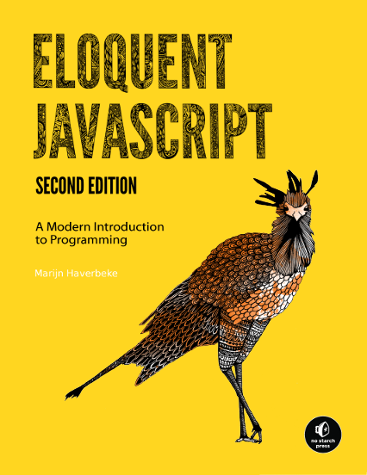
Continued Practice: Eloquent JavaScript
Among the best all-around introductions to JavaScript
Chapters 1 through Chapter 5 are appropriate for your experience level
Practice problems get challenging really fast!
Available for free online
BOOTCAMP PREP

Slide 9
Continued Practice: CodeWars
Great source for a steady stream of JavaScript problems.
Some caveats:
1. Be careful that you don’t dive into extremely advanced problems, that prevent you from practicing and mastering your fundamentals.
2. CodeWars allows you to check out other users’ solutions. This is a great opportunity to learn, but be aware that the most up-voted solution is usually the shortest, and probably not the best.
BOOTCAMP PREP

Slide 10
Continued Practice: Project Euler
Assessments test coding ability, but they also test logic/mathematical thinking.
Some takers report feeling comfortable with the coding concepts, but not with some of the analytical problem solving that was required.
Project Euler is a great source for math-oriented problems, including algorithmic problems.
BOOTCAMP PREP

Slide 11
Continued Practice: Personal Project
One of the best ways to stay motivated and continue learning is to work on a personal project.
Build a portfolio site, tic tac toe (in a browser window), sudoku solution - making it real, conways game of life, build a cool node project (text a number it texts a group of friends for you)
Some resources for that are:
1. Team Treehouse
2. Code School
3. Codecademy
4. freeCodeCamp
BOOTCAMP PREP

Slide 12

Admissions Info
Step One: Take No-Risk Assessment at the end of BCP
Step Two: Submit Application (and take Stage 1 Assessment if needed)
Step Three (if invited): Technical Interview via Skype
Decisions can be returned in as little as 3-5 business days after completing the admissions process
For any further questions, email admissions@fullstackacademy.com
BOOTCAMP PREP

Slide 13

Talent is a pursued interest. Anything that you're willing to practice, you can do.
- Bob Ross

